Slide 1
Mini Research Series Final Week: Summary
Colin Young
Easyday Education
January 2024

Slide 2
What have we covered?
Concepts
Differential Equations
Fixed-point Analysis
Numerical Methods
Euler Method
Newton-Raphson Method
Python Implementation
Iterations
Graph Plotting
Sum of Squared Difference
Lists & Arrays
Parameter Fitting
Simple Linear Regression

Slide 3
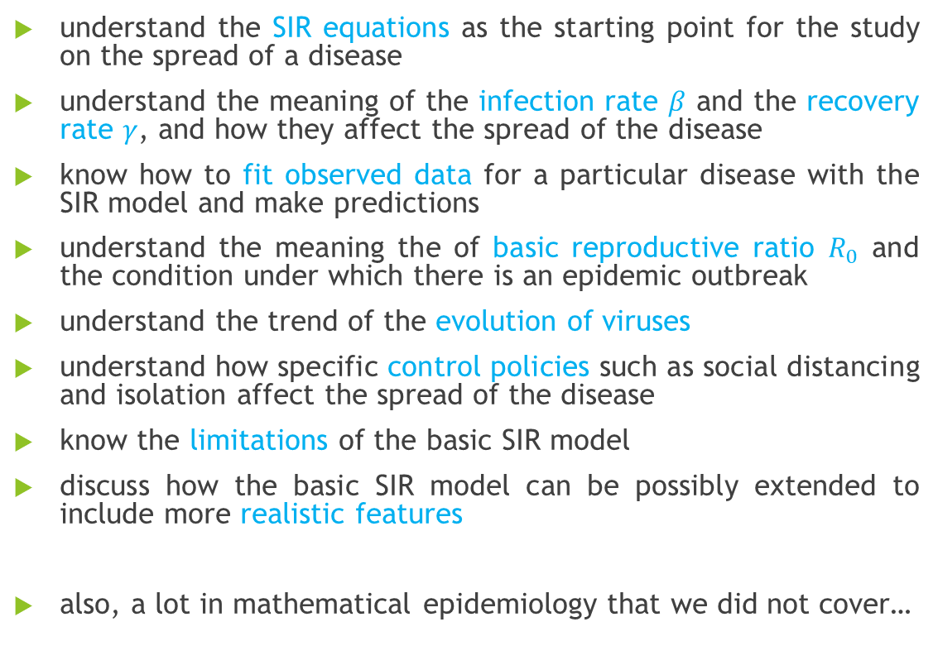
What have we covered?
understand the SIR equations as the starting point for the study on the spread of a disease
understand the meaning of the infection rate $β$ and the recovery rate $γ$, and how they affect the spread of the disease
know how to fit observed data for a particular disease with the SIR model and make predictions
understand the meaning the of basic reproductive ratio $R_{0}$ and the condition under which there is an epidemic outbreak
understand the trend of the evolution of viruses
understand how specific control policies such as social distancing and isolation affect the spread of the disease
know the limitations of the basic SIR model
discuss how the basic SIR model can be possibly extended to include more realistic features
also, a lot in mathematical epidemiology that we did not cover…

Slide 4
Summary by week
Week 1: Python Basics
basic data structures: lists, numpy arrays, …
for loops & iterations
functions
graph plotting with matplotlib package
Week 2: Numerical Methods to ODEs
review for simple 1st order ODEs
numerical solution to 1st order ODEs
Euler method
mid-point method
implementation with Python
comparison of analytical to numerical solution

Slide 5
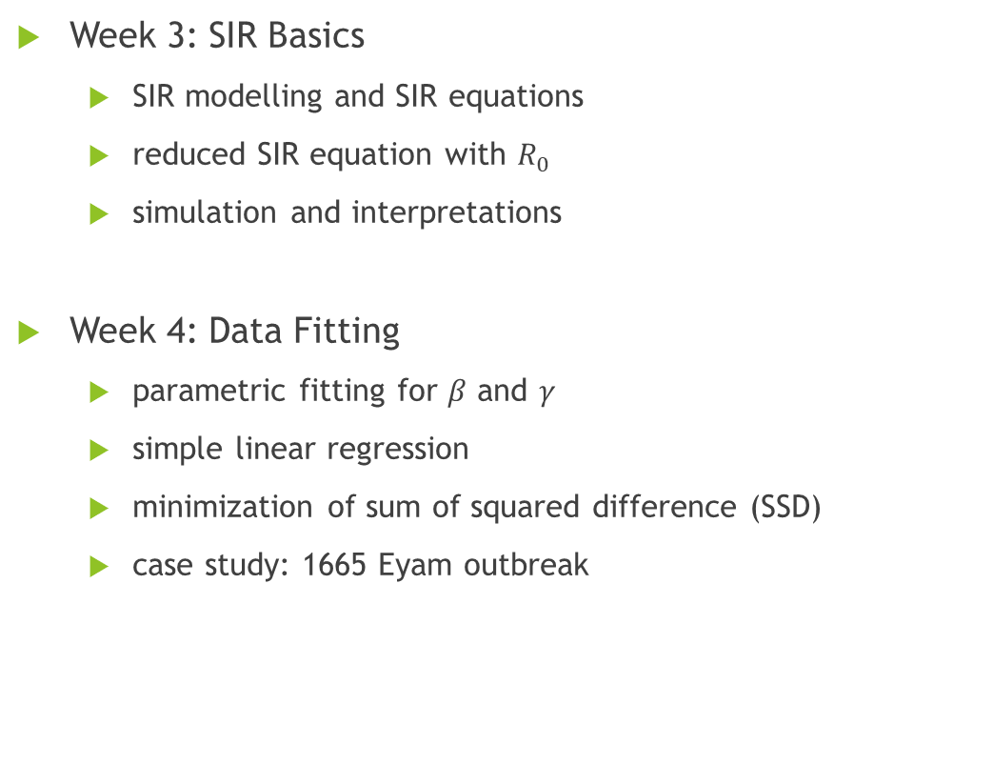
Summary by week
Week 3: SIR Basics
SIR modelling and SIR equations
reduced SIR equation with $R_{0}$
simulation and interpretations
Week 4: Data Fitting
parametric fitting for $β$ and $γ$
simple linear regression
minimization of sum of squared difference (SSD)
case study: 1665 Eyam outbreak

Slide 6
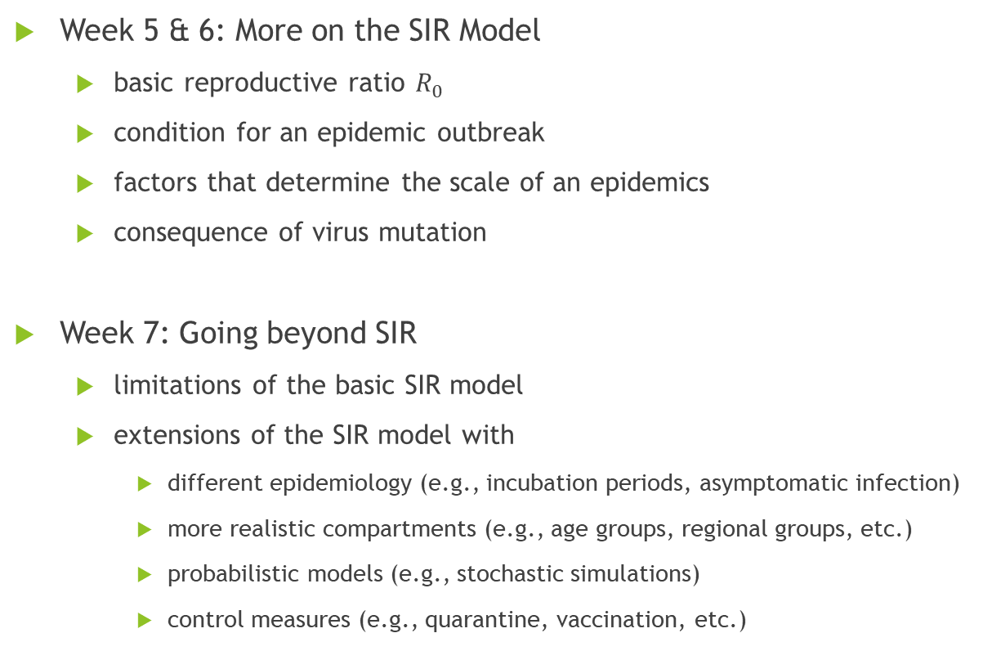
Summary by week
Week 5 & 6: More on the SIR Model
basic reproductive ratio $R_{0}$
condition for an epidemic outbreak
factors that determine the scale of an epidemics
consequence of virus mutation
Week 7: Going beyond SIR
limitations of the basic SIR model
extensions of the SIR model with
different epidemiology (e.g., incubation periods, asymptomatic infection)
more realistic compartments (e.g., age groups, regional groups, etc.)
probabilistic models (e.g., stochastic simulations)
control measures (e.g., quarantine, vaccination, etc.)

Slide 7
Web Resources
Most of the ideas of the mini research lectures come from the brilliant online resources listed below:
Jeffrey R. Chasnov, Mathematical Biology, Lecture notes for MATH 4333
https://www.math.hkust.edu.hk/~machas/?menu=3
Andrew French, BPhO Computational Physics Challenge Online Course 2023
https://www.youtube.com/watch?v=Qlfv77GPS5Y
Robin Thompson, How do mathematicians model infectious disease outbreaks?, Oxford Mathematics Public Lecture 2020
https://www.youtube.com/watch?v=m6Hr69JH_wA

